Slide 1
Lecture 13 Welcome to the Real World
CSCI – 3350 Software Engineering II
Fall 2014
Bill Pine

Slide 2
Lecture Overview
Reality of job security
Implications of “.com bubble”
Politics
Best Practices Perverted

Slide 3
Reality of Job Security
In the late 1950’s, mid 1960’s
One lifelong employer
Employers valued experience
Employees enjoyed job security
Over the last 2 decades
Average term of employment
Dropped from 15 years
To less than 3 years

Slide 4
Reality of Job Security (continued)
Reasons for decline
Needed skills set has become more fluid
People have developed an entitlement mentality
Globalization
Foreign workers have become more skilled
The “run-up” of stock prices in the “. com” bubble
All are important contributors to decline
The last arguably provided the greatest acceleration

Slide 5
.com Bubble
The illusion of a “new economic paradigm”
Media hyping of high tech initial offerings
Big bucks are being made
Don’t worry about a business model
Vague promise of future earnings
Anything that uses tech is a guaranteed winner
Channeled a disproportionate share of capital into tech ventures
“Old-line” blue-chip firms were capital starved

Slide 6
.com Bubble (continued)
Capital starvation only intensified the emphasis on short term profits
Stockholder pressure
Origins in the merger and buyout frenzy of the previous decade
End result
Anything that did not contribute to the short-term bottom line was “axed”
Short term = Next quarter

Slide 7
.com Bubble (continued)
Revised the way that a company “did business”
Supply chain economics
Dell production model
Produced many necessary changes
Major casualty
Employer loyalty to employees
Employee loyalty to employers

Slide 8
Implication for the Employee
No longer will an employer “look out for the employee”
Your future is your responsibility
With apologies to the late Dr. Sanderson
“In the final analysis, each person is responsible for his own employment.”
Remember: The only justification for your job is to make money for the business owner
Is this perhaps a little frightening?

Slide 9
Proactive Employee
To get and keep a job
You must be a top performer
Foreign outsourcing is still a threat
You can’t (or chose not to) compete on price (salary)
Your only chance
Productivity

Slide 10
Productivity
The American worker is the most productive worker in the world
W R O N G

Slide 11
Your Weapons
These remedies are necessary but not sufficient
Threat | Remedy
Dynamic skills set | Continuing education
Entitlement mentality | Realize no one owes you anything
Globalization | Maximize your productivity
Increasing foreign worker skills | All of the above

Slide 12
Politics
“All politics are local”
Tip O’Neil
Corollary
“All activities have a political component”
Many employees
Because of
Laziness
Incompetence
Enhancement
Innate meanness
Practice office guerilla warfare

Slide 13
Politics (continued)
You will not be able to avoid politics
Nor will you be untouched by it
“Up until now, there probably hasn’t been anyone who has been out to get you. This will change the minute you graduate and go out into the real world.”
Ben Ginsberg
Just because you do not take an interest in politics doesn't mean politics won't take an interest in you!
- Pericles (430 B.C.)

Slide 14
Politics (continued)
You must be attuned to workplace politics
“Those who are too smart to engage in politics are punished by being governed by those who are dumber”
Plato

Slide 15
The “Real” Project Phases
The five phases of any project
Unbridled enthusiasm
Ballooning problems
Search for a scapegoat
Punishment of the innocent
Praise and reward for the “looters and moochers”

Slide 16
The Doomed Project
When a project heads south,
The manager who was yesterday “singing your praises”, will today say to his boss,
“I knew that that *&*^$%* Bill would screw it up.”
“ I told him it wouldn’t work.”
“But would he listen to me?”
“Oh, no!”
“He had to do it his way.”

Slide 17
The Doomed Project (cont)
The aftermath
“The only people who got along were like-minded individuals who banded together. They resembled bands of chattering monkeys, who, when trouble strikes, head for the treetops, scolding whoever and whatever is left below.”
- Sheldon Bowles

Slide 18
The Evil Boss

Slide 19
Weapons in Office Warfare
Best defense
Exemplary Performance
Awareness and Use of a “Paper trail”
Growing threat of corporate espionage
Employers monitor their employees
Email
Computers
Network traffic
Office Furniture (Desk, Filing Cabinets)
All are property of the company

Slide 20
Weapons (continued)
Must be circumspect with any insurgency
No need to make the “opposition” nervous
Keep records away from workplace
To counter tactics used by your enemies
Shredding (Iran Contra, Enron, Arthur Anderson, Holder DOJ)
Not documented on employers’ storage devices
Not shared in email
If you need a face-to-face with co-workers, go to an out-of-the-way restaurant or bar

Slide 21
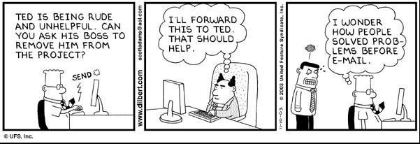
The Email Bomb

Slide 22
Best Practices
You may find that your organization does not follow the current set of best engineering practices
The core drivers
Time-to-market pressures
Liquid specifications
Complexity

Slide 23
Time-to-Market Pressures
Best practices
Requires extra effort
Extra effort translates directly into additional time
Competitive forces
The product out the door as soon as possible
Hopefully within budget
Does this seem stupid?
If you don’t have time to do it right, do you have time to do it twice?
Answer
No, but we will get it right on the next version

Slide 24
Liquid Specifications
Rushed development is guaranteed to lead to a poor product specification
Customer driven
Marketing driven
This is the phase into which you should pour your extra effort
Don’t wait until the coding workflow

Slide 25
Complexity
OS | LOC
PC DOS v 1.0 | 4,000
Windows NT 3.1 | 6,000,000
Windows 98 | 18,000,000
Windows 2000 | 35,000,000
Windows XP | 45,000,000
Vista | 75,000,000
Source for pre-Vista estimates: Software Exorcism, Bill Blunden, Apress, 2003.

Slide 26
Complexity (continued)
For the maintenance programmer
Updates and fixes will be “quick and dirty”
Adds to project complexity
May inject more errors than it fixes
If the original product was complex
No “easy in / easy out” fixes
Fixes become
Expensive
Larger fault injectors

Slide 27
General Defensive Strategies
Trade Features for time, or new features for old
Get it in writing
Intentional ambiguity
Military Basic Training example
Aggressively pursue requirement specification
Get a signature
To address Plausible Deniability
Maintain a paper trail
Email
Memo for the record

Slide 28
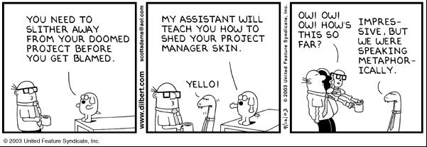
Alternative Defense

Slide 29
Defensive Development Checklist
Strong cohesion
Loose coupling
Idiot proofing
Crash gracefully
Minimized globals
Event logging
Document code intent
No literal constants
All units tested
Path coverage testing
All requirements tested
Eliminate compiler warnings
This list maintained
Source: Software Exorcism, Bill Blunden, Apress, 2003.

Slide 30
Best Practices Perverted
Project artifacts
Almost surely will be out of date
Few organization possess the
Discipline
Resources
Motivation
to properly maintain artifacts

Slide 31
Effect on Best Practices (continued)
Source code internal documentation especially unreliable
For the same reasons as for artifacts
Deliberate inaccuracies due to attempt at job preservation
You will want to believe internal documentation
Be skeptical

Slide 32
Worlds of Software†
There are different worlds of software development
Different rules apply
“The 20MB runtime required for .NET is a NON issue”
Joel Spolsky’s “The Five Worlds”
Shrinkwrap
Internal
Embedded
Games
Throwaway
†

Slide 33
Worlds vs. Processes
In SE-I and SE-II
Introduced a wide spectrum of methodologies, tools, process, and techniques
Not all tools will be used in all worlds
When entering a new world
Don’t think you have all the answers
Learn the world
Critically evaluate the world process against you have learned
Choose and use those practices that are appropriate

Slide 34
Your New World
Suppose you find that your new world doesn’t do … , and you think they should
Strategies (Joel again)
Just do it
Create a pocket of excellence
Harness the power of viral marketing
Neutralize the Bozos
Get away from interruptions
Become invaluable

Slide 35
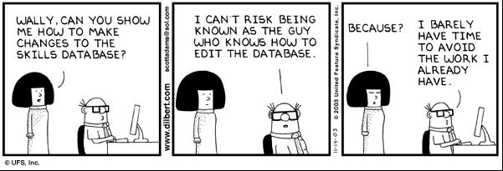
Job Preservation

Slide 36
Worse Case Scenario
The appearance of the “pink slip”
Mitigation strategy – an ongoing effort
Make contacts and build a professional network
Keep your skills up to date
Resume up to date
Always be alert for a new job

Slide 37
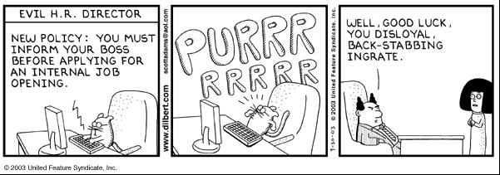
May Be Unpleasant

Slide 38
Expectations
Definition
Your boss’s vision of your future output
Performance drives expectation
Your bosses expectations will be initially low
With each “win,”
Rewards will accrue
Expectations rise
Avoid becoming a living “Peter Principle”

Slide 39
Managing Expectations
Establish and maintain your credibility
Know your capabilities (what you can deliver)
Set clear realistic goals with the boss
Negotiate realistic schedules
Communicate risks
Continuously monitor your progress
Communicate early and frequently
Continuously improve your personal process
Delmer Principle – Build for the future

Slide 40
Be a Winner
How do you (your boss) distinguish between a winner and a loser?
When informing the boss of a problem,
Have at least two plans for addressing the bottleneck
Bottom line,
A winner finds a way to make it happen
A loser has dozens of excuses, why it can’t be done

Slide 41
No Excuses
Previous defense discussions may have led you to believe that I am recommending that you build a line of documented excuses as an effective barrier to job preservation
You could not be more wrong

Slide 42
Summary
Know your world
To the best of your ability
Adhere to the best practices
Keep up-to-date on best practices
Document critical issues
Be skeptical
Manage expectations
Remember
It’s not paranoia if they really are out to get you!
Email me your good and not so good experiences
“Be careful out there”
- Sgt. Esterhouse

Slide 43
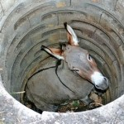
An Inspirational Story

Slide 44
The Moral of the Story
Five Simple Rules for a Happy Life
Life is going to shovel dirt on you, all kinds of dirt
Shake it off and step up
Each of life’s problem is a stepping stone
We can get out of the deepest well, by never giving up
Shake it off and step up (SDM principle)

Slide 45
Enough Sweetness and Light
The donkey later came back, and bit the buttocks of the farmer who had tried to bury him. The gash from the bite got infected and the farmer eventually died in agony from septic shock.
The Real Moral ?

